Slide 1
Overview of Leadsquared
Development Topics

Slide 2
Learning Objective
In this module, we will…
Understand APIs through definition and various examples
Understand various uses of APIs
Brief overview of Lapps and Webhooks
Learn about Custom menus for Web application
Note: Each slide has more information in the notes section. Request you to read them to learn more about each topic.

Slide 3
API overview

Slide 4
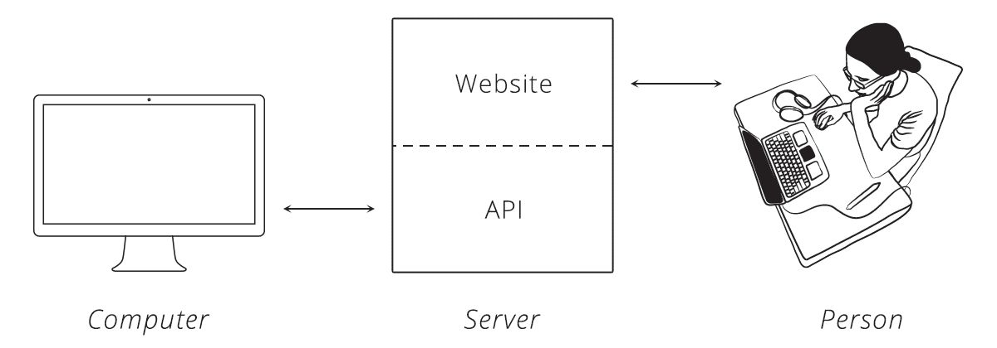
What is an API
An API is the tool that makes a website's data digestible for a computer. Through it, a computer can view and edit data, just like a person can by loading pages and submitting forms.

Slide 5
Terminology recap
Server: A powerful computer that runs an API
API: The "hidden" portion of a website that is meant for computer consumption
Client: A program that exchanges data with a server through an API

Slide 6
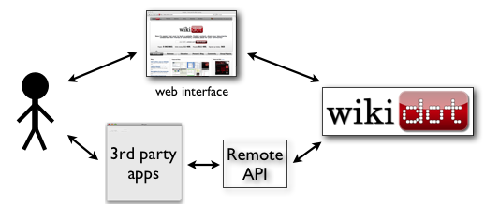
How is an API used?
A great example is a smartphone app that syncs with a website. When you push the refresh button in your app, it talks to a server via an API and fetches the newest info.
Notes:
When two systems (websites, desktops, smartphones) link up through an API, we say they are "integrated." In an integration, you have two sides, each with a special name. One side we have already talked about: the server. This is the side that actually provides the API. It helps to remember that the API is simply another program running on the server . It may be part of the same program that handles web traffic, or it can be a completely separate one. In either case, it is sitting, waiting for others to ask it for data.
The other side is the "client." This is a separate program that knows what data is available through the API and can manipulate it, typically at the request of a user. A great example is a smartphone app that syncs with a website. When you push the refresh button in your app, it talks to a server via an API and fetches the newest info.
The same principle applies to websites that are integrated. When one site pulls in data from the other, the site providing the data is acting as the server, and the site fetching the data is the client.

Slide 7
HTTP Requests
Request-Response Cycle: The client sends the server a request to do something. The server, in turn, sends the client a response saying whether or not the server could do what the client asked.
To make a valid request, the client needs to include four things:
URL (Uniform Resource Locator) ¹
Method
List of Headers
Body
Notes:
URL: In HTTP, a URL is a unique address for a thing (a noun). Which things get addresses is entirely up to the business running the server. They can make URLs for web pages, images, or even videos of cute animals.
APIs extend this idea a bit further to include nouns like customers, products, and tweets. In doing so, URLs become an easy way for the client to tell the server which thing it wants to interact with.
METHOD:
The request method tells the server what kind of action the client wants the server to take. In fact, the method is commonly referred to as the request "verb."
The four methods most commonly seen in APIs are:
GET - Asks the server to retrieve a resource
POST - Asks the server to create a new resource
PUT - Asks the server to edit/update an existing resource
DELETE - Asks the server to delete a resource
In LeadSquared, we support 2 standard HTTP methods – GET and POST.
Headers :
Headers provide meta-information about a request. They are a simple list of items like the time the client sent the request and the size of the request body.
Body:
The request body contains the data the client wants to send the server.

Slide 8
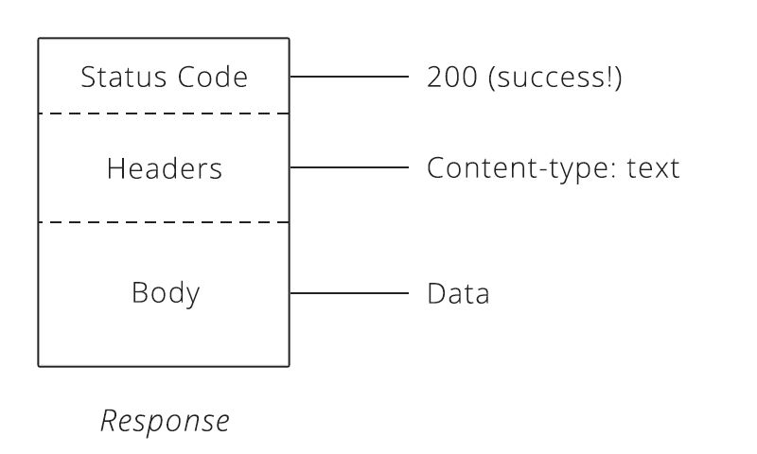
HTTP response
After the server receives a request from the client, it attempts to fulfill the request and send the client back a response.
HTTP responses have a very similar structure to requests.
The main difference is that instead of a method and a URL, the response includes a status code.
Notes:
Status Codes
Status codes are three-digit numbers that each have a unique meaning. When used correctly in an API, this little number can communicate a lot of info to the client.
Ex: 404, The status code behind this response is 404, which means "Not Found." Whenever the client makes a request for a resource that does not exist, the server responds with a 404 status code to let the client know: "that resource doesn't exist, so please don't ask for it again!"

Slide 9
How APIs build on HTTP
A lot of business potential.
A simple tweak to the request method was the difference between telling the server to create a new order or cancel an existing one. It was easy to turn the desired business outcome into an instruction the server could understand.

Slide 10
Authentication : API Keys
Every API call requires an accessKey and secretKey to be passed in the API URL for authentication.
Any action performed using APIs uses the credentials of the user whose keys are passed.
These keys are unique for every user and carry many privileges, so be sure to keep them secret!
All API requests must be made over HTTPS. Calls made using plain HTTP will fail.
You can access your account’s accesskey and secretkey from Settings → APIs and Webhooks → API Access keys
Notes:
Ideally, you should use the accessKey and secretKey of an Admin user so you don’t face any restrictions associated with other user roles like Marketing Users or Sales User.
Make sure that you use the API keys of an active user. If a user leaves your organization and you deactivate the user, the API keys are also deactivated and API calls with those keys will fail.
If your keys are incorrect, then you’ll receive a “401 Unauthorized” response.

Slide 11
HTTP Response Code
Code | Description
200 OK | This is the status code for successful API call.
401 Unauthorized | The API call was made with invalid access credentials. Check your AccessKey and SecretKey.
400 Bad Request | The message body on the request is not as per API specification. Make sure that content type is set to “application/json” and the JSON body has correct attribute names and structure.
404 Not Found | The API could not be found. Please check the API signature.
429 Too Many Requests | API calls exceeded the limit of 25 in 5 second(s)
500 Internal Server Error | The API called failed. There could be many reasons for it. Check the exception message to get more details.

Slide 12
Sample API code
We can test each API call with raw JSON input through a TRY IT button on each API page.
Go to https://apidocs.leadsquared.com/ to access the sample APIs in Leadsquared
We will now explore the create new lead API under Lead Management APIs : CREATE

Slide 13
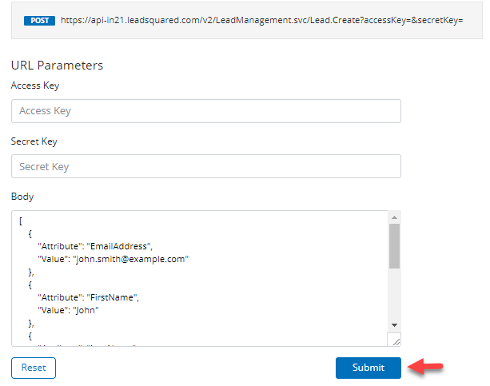
In API testing pop-up, enter your Access Key and Secret Key, then click Submit.

Slide 14
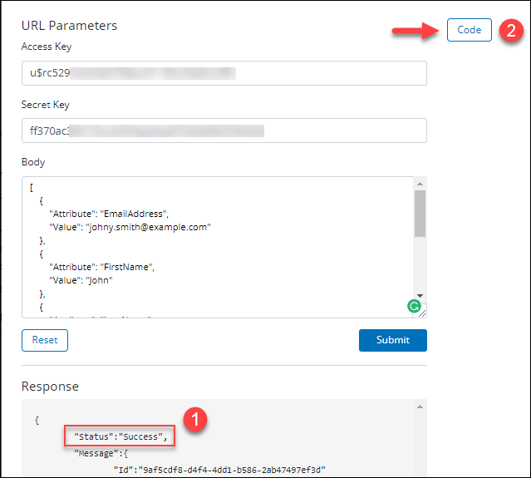
Once you get a successful response, a Code button will appear on the top left side of the pop-up. Click it to open the sample code generator.

Slide 15
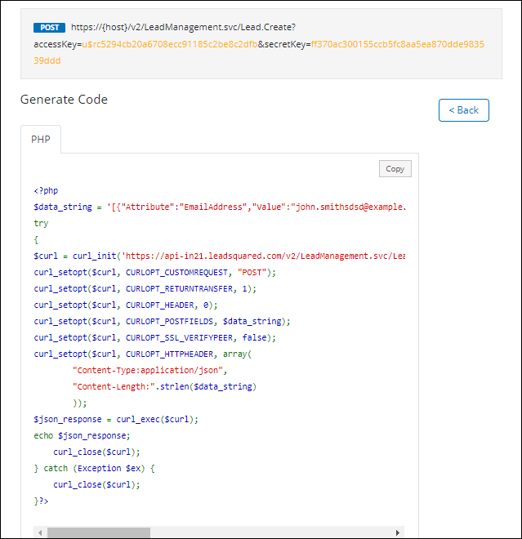
Choose your preferred programming language, then click Copy. You can now paste the code in your client.
Notes:
Only PHP is currently available language

Slide 16
DIFFERENT KINDS OF API IN LSQ
There are a lot of APIs in Leadsquared.
They range from APIs involved with Product features like Lead management or task management all the way to Webhooks and Lapps.
For each option we can create API depending on the need.
Notes:
Different kinds of API in LeadSquared:
Lead Management
Lead Activity Management
Sales Activity Management
List Management
Task Management
User Management
Sales Group Management
Team Management
Account (Company) Management
Account Activity Management
Entity Sharing
Tag Management
Email Marketing
Landing Pages
Telephony
Custom Tabs & Actions
Custom Menus
Notifications
Portal API
Analytics
Lapps
Webhooks
Scripts

Slide 17
Webhooks Overview

Slide 18
What is a Webhook?
Webhooks are HTTP callback requests sent to a URL of your choice in response to
some Event occurring.
An Event is an action or occurrence recognized by software like clicking on a certain button of the host site.
When an Event occurs in the source site, webhooks makes an HTTP request to the URL configured.
A webhook delivers data to other applications as it happens, meaning you get data immediately.
Notes:
Prerequisites
You must be an admin user.
You must have a webhook URL you want to send data to.
Webhooks typically are used to connect two different applications.
When an event happens on the trigger application, it serializes data about that event and sends it to a webhook URL from the action application—the one you want to do something based on the data from the first application.

Slide 19
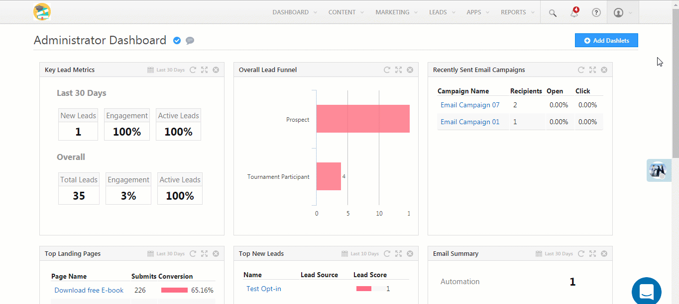
Getting Started: Create a Webhook
Notes:
Navigate to My Account→ Settings→ API and Webhooks → Webhooks.
Fill in the webhook details. The Event (triggers the HTTP callback request) and Webhook URL fields are mandatory.
Click Save when you’re done
Type :Select ‘Webhook’ to create a regular webhook. Select ‘Lapp’ to create a new Lapp
Event : The LeadSquared event you want to trigger the HTTP callback request on. Use the checkbox to ‘Notify on failure’ for failed webhook executions. If checked, all administrator users in the LeadSquared account will be notified.
Webhook URL :The URL you want to post data to once the event occurs.
Content Type: The format you want to post the data in. Choose from ‘application/json’ to post data in JSON format, ‘application/x-www-form-urlencoded’ for simple text/ ASCII data or ‘text/plain’ for plain text.
Execution Delay: You can set a delay (in seconds) between the time the event occurs and the data is posted.
Custom Headers : Add a name-value pair as a custom header. You can use custom headers for authentication or security purposes
Description: Describe your webhook

Slide 20
Lapps

Slide 21
What is a LApp?
A Lapp is a REST API that can execute some custom code. It is built, deployed and run right inside LeadSquared.
Once published, Lapps code can be triggered by automations, rules and webhooks and can also be called from external systems.
Lapps lets you develop faster, test faster and deploy faster without having to worry about security, hosting, downtime, debugging or troubleshooting.

Slide 22
Benefits of Lapp
Ease of Integration | Easily integrate with other systems.
Speed | Develop applications faster.
Testing | Test faster using the Lapps test environment.
Security | You don’t have to worry about security or data encryption.
Hosting | There’s no need to maintain the source code or worry about version history.
Troubleshooting | Easy logging, debugging and troubleshooting.
Reliability | You don’t have to worry about reliability or server downtime.
Scalability | You don’t have to be concerned with scalability or handling API call volumes. LApps can be scaled to meet as many executions as you need.

Slide 23
When to create LApp?
If you have complex business processes that are not supported by the prebuilt application, Lapps gives you a way to implement custom functionality.
Use Lapps to –
Create dynamic email responses to your contacts and prospects to ensure the content is relevant.
Quickly send lead and activity data to your other SaaS and web apps.*
Receive data from your other SaaS and web apps.
Do custom calculations.
Create business processes that aren’t supported by Automation.
Notes:
The prebuilt LeadSquared application provides numerous customization options to fit your business needs.
Create dynamic email responses to your contacts and prospects to ensure the content is relevant.
Travel packages based on lead’s interest.
Real estate properties based on lead’s interest.
Details of the right insurance plan for a lead
Quickly send lead and activity data to your other SaaS and web apps.*
Invoice apps.
Quote apps.
Order Management.
Receive data from your other SaaS and web apps.
Chat apps.
Do custom calculations.
Compute custom lead priority score based on your own business logic.
Generate the right insurance premium for a lead.
Calculate interest rates for leads based on LeadSquared and third-party data.
Calculate discount based on your own rules.
* Although this can also be achieved by LeadSquared APIs, with Lapps, you won’t have to change your main application code every time there are small changes in your business logic. All you’ll have to do is update the Lapp.

Slide 24
Working of LApps and Limitations
Lapps runs on a Node.js server(v8.10) and currently supports code only in JavaScript. When you write code in Lapps and publish it to a test or live environment, you get an API URL that you can use to read/send data within LeadSquared or to and from an external system.
Some Limitations
Only LeadSquared Administrator users have access to Lapps.
You can’t import libraries or your local project. You have to write the code in the Lapps editor.
The Lapps editor only supports Javascript currently.

Slide 25
Getting Started
The Manage Lapps UI is available under the Apps section
of the main navigation panel –
Notes:
You can create new Lapps here and view and edit previously created Lapps. The grid shows you the following information for each Lapp –
Column Name Description Name The name of the Lapp. Status The status (Draft, Published, Unpublished) of the Lapp in the test and live environments. Last Published On The date the Lapp was last published in the test and live environments. API Call Statistics* The number of successful or failed API calls for the test and live environments. Hover the mouse over the success or failure statistics to see a breakdown of the number of successful and failed calls by environment. Modified On The last modified date of the Lapp. Modified By The user who last modified the Lapp. Actions Edit a Lapp.
Unpublish a Lapp from the test environment.
Unpublish a live Lapp.
View the Lapp API URL.
Delete a Lapp.
View logs.
You can also sort the grid to show Lapps by status, modified by and modified on filters.
*API call statistics are shown for last 30 days by default and cached every 12 hours. It does not change with the grid’s filter. You can view the latest values using the refresh button provided alongside.

Slide 26
Custom menus

Slide 27
Custom Menu for Web
Allows you to create custom menu tabs in your LeadSquared web application.
These tabs appear in your navigation menu and let you access external URLs or third-party websites directly from your LeadSquared account.
We need to install the connector ‘Custom Menu for Web’
Notes:
Navigate to Apps>Apps Marketplace>UI Customization and click Install on the Custom Menu for Web app.

Slide 28
Configuration for Web app
Notes:
Once installed, under Settings, click Configure on the Custom Menu for Web connector page.
On Configure Custom Menu For Web App menu, click the Add Custom Menu button.
Title – Enter a title for the custom menu.
URL – Enter the URL of the third party website here.
Visible For – Select the user roles you want the custom menu to be visible for.
Click Save. Use the Add Custom Menu button to add another custom tab.

Slide 29
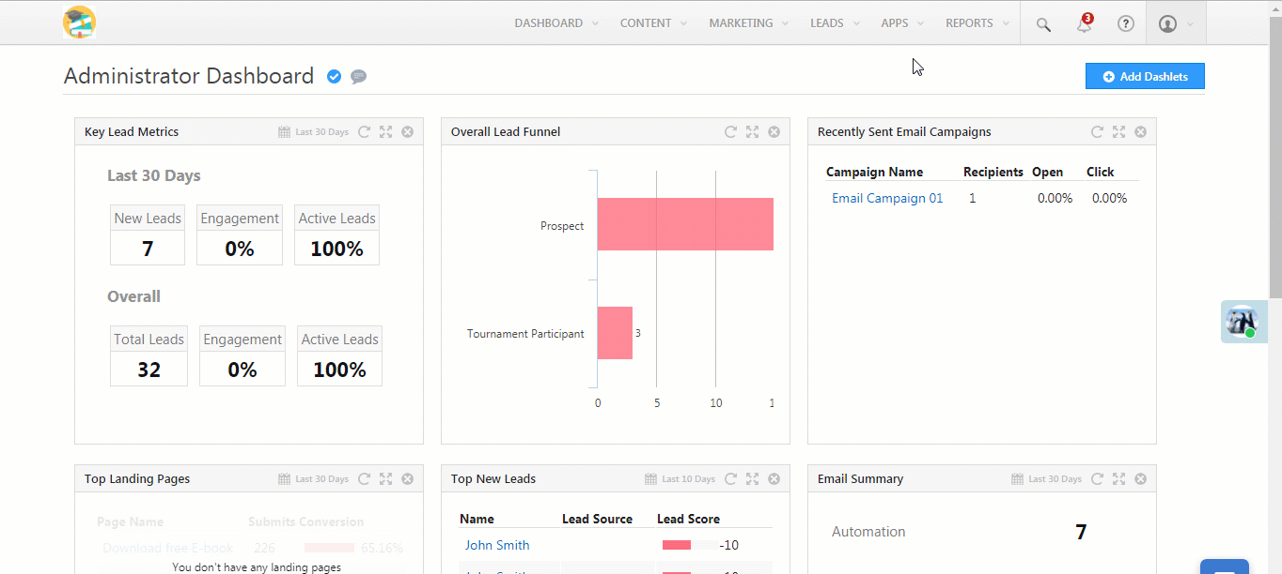
Navigation
The custom tab will appear under the Apps menu after you’ve successfully configured it.

Slide 30
Thank You

